Slide 1


Organizational Behavior
(MGT-502)
Lecture-19

Slide 2
Summary of
Lecture-18

Slide 3


Teams

Slide 4


Clearly Stated Objectives
Real &
Symbolic
Needs
Successes
Reinforce
Commitment
Strength
Though
Adversity
Diverse Objectives
Linked by A
Common Purpose
Mutually
Supportive
Notes:
56

Slide 5

High Performance Teams
Char’s
Strong core values
Specific performance objectives
Right mix of skills
Creativity

Slide 6
Factors Affecting Teams
Work Design
Team Composition
Context
Process

Slide 7





Problem-
Solving
Self-
Managed
Types of
Teams
Virtual
Cross-
Functional

Slide 8
Turning Individuals
Into Team Players
Selection
Training
Rewards

Slide 9
Today’s Topics

Slide 10
Triangle for Managing in the New Team Environment
Manager
Team
Individuals
Notes:
25

Slide 11
Deciding When to Use a Team
Use a Team When:
  Many perspectives are needed
  Acceptance of the decision is critical
  The problem is complex or unstructured
  Individuals judgments are unreliable
  Individuals are unwilling to take necessary risks
  You want to develop team members’ team-related skills

Slide 12
Deciding When to Use a Team
Be Cautious About Using a Team When:
  The issue is unimportant
  Individuals don’t want to participate
  Individual risk preferences are too high
  Time is of the essence
  Group norms are unacceptable

Slide 13
Guidelines for Dealing with Problem Behaviors
Choose team members carefully.
Offer training.
Provide clear goals.
Clearly define member responsibilities.
Use peer evaluations.
Reward superior performance.
Don’t let social considerations overwhelm concern with the task.
Remove problem team members as a last resort.

Slide 14
Is it true that
everyone’s
responsibility is, in
reality, nobody’s
responsibility?
-- Anonymous

Slide 15
Developing Effective Teams
Training
Empowerment
Team Effectiveness
Rewards
Communications

Slide 16
Building Trust
Work for others’ interests as well as own
Be a team player.
Practice openness.
Be fair.
Speak your feelings.
Show consistency in basic values.
Maintain confidence.
Demonstrate competence.
Notes:
Material pertinent to this illustration is found on page 297-298.

Slide 17

Group Problem Solving Techniques
Consensus presenting opinions and gaining agreement to support a decision
Brainstorming process to generate a quantity of ideas
Nominal Group Technique process to generate ideas and evaluate solutions
Delphi Technique process to generate ideas from physically dispersed experts
Computer-Aided Decision Making

Slide 18
Group Decision Making
1) more knowledge through pooling of group resources
2) Increased acceptance & commitment due to voice in decisions
3) greater understanding due to
involvement in decision stages
Advantages
1) pressure in groups to conform
2) domination by one forceful member or dominant clique
3) amount of time required, because group is slower than individual to make a decision
Disadvantages

Slide 19
Consensus Decision
A proposal that is acceptable enough that all members are willing to support it.

Slide 20

CONSENSUS IS:
A proposal acceptable enough that all members can support.
Notes:
NOTES:
_________________________________________________________________________________________________________________________________________________________________________________________________________________________________________________________________________________________________________________________________________________________________________________________________________________________________________________________________________________________________________________________________________________________________________________________________________________________________________________________________________________________________________________________________________________________________________________________________________________________________________________________________________________________________________________________________________________________________________________

Slide 21
Consensus Decision-Making
Requires time
Active participation of all group members
Communication skills
Creative-thinking and open-mindedness
Notes:
NOTES:
_________________________________________________________________________________________________________________________________________________________________________________________________________________________________________________________________________________________________________________________________________________________________________________________________________________________________________________________________________________________________________________________________________________________________________________________________________________________________________________________________________________________________________________________________________________________________________________________________________________________________________________________________________________________________________________________________________________________________________________

Slide 22
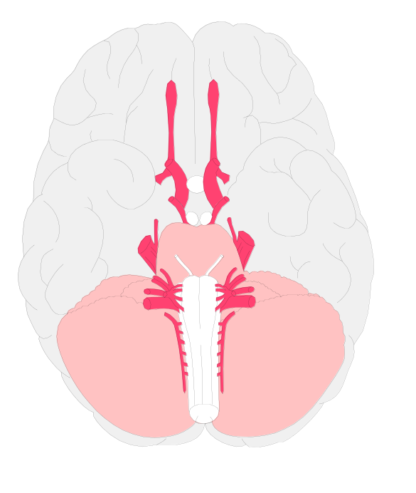
Two Brains, Two Cognitive Styles
Left Hemisphere
Right Hemisphere
Verbal
Sequential, temporal, digital
Logical, analytic
Rational
Western thought
Nonverbal, visuospatial
Simultaneous, spatial,
analogical
Gestalt, synthetic
Intuitive
Eastern thought

Slide 23
The
Decision-
Making
Process
Recognize the problem and
the need for a decision
Identify the objective of
the decision
Gather and evaluate data
and diagnose the situation
List and evaluate
alternatives
Notes:
3

Slide 24
The
Decision-
Making
Process
Select the best
course of action
Implement
the decision
Gather
feedback
Follow up
Notes:
4

Slide 25
How do groups make decisions?
How groups make decisions.
  Decision by lack of response.
  Decision by authority rule.
  Decision by minority rule.
  Decision by majority rule.
  Decision by consensus.

Slide 26
How do groups make decisions?
Potential advantages of group decision making.
  More knowledge and expertise is applied to solve the problem.
  A greater number of alternatives are examined.
  The final decision is better understood and accepted by all group members.
  More commitment among all group members to make the final decision work.

Slide 27
How do groups make decisions?
Potential disadvantages of group decision making.
  Individuals may feel compelled to conform to the apparent wishes of the group.
  The group’s decision may be dominated by one individual or a small coalition.
  Group decisions usually take longer to make.

Slide 28
How do groups make decisions?
How to improve group decision making.
  Brainstorming.
  Nominal group technique.
  Delphi technique.
  Computer-mediated decision making.

Slide 29
How do groups make decisions?
Brainstorming.
  Group members actively generate as many ideas and alternatives as possible, and they do so relatively quickly and without inhibitions.
  Brainstorming rules.
    All criticism is ruled out.
    Free-wheeling is welcomed.
    Quantity is wanted.

Slide 30
Brainstorming
Goal is to maximize the quantity and quality of ideas.
Rules
  Expressiveness of any idea
  Non-evaluation during generation phase
  Quantity, generate as many ideas as possible
  Build on ideas expressed by others

Slide 31
How do groups make decisions?
Nominal group technique.
  A form of structured group decision making that enables everyone to participate and have his/her ideas heard without hostile criticism or distortions.
  A structured voting procedure is used to prioritize responses to the nominal question.

Slide 32
Nominal Group Technique
Problem is presented
Each members writes silently for 10 min
Members state their ideas
Team discusses each idea getting clarification
Members privately rank the five best ideas they prefer

Slide 33
Stepladder Technique
A decision making approach in which members are added one by one to a team.
Two people starts a discussion of the task.
Another member is added and then presents their ideas to the group.
Then another and so on until decision is made.

Slide 34
How do groups make decisions?
Delphi technique.
  Used in situations where group members are unable to meet face to face.
  The process.
    A series of questions is distributed to a panel.
    Panel members submit their responses to a decision coordinator.
    The decision coordinator summarizes the responses, and sends the summary along with a follow-up questionnaire to the panel.
    Panel members send in their responses.
    The process is repeated until a consensus is reached.

Slide 35
Delphi Technique
For groups who do not meet face to face.
Leader distributes topic or task
Each member responds
Leader collect responses and send back to team and solicits feedback.
Process is repeated until there is resolution on the issue in question.

Slide 36
Quality Circles & Teams
Quality circles (QC) - a small group of employees who work voluntarily on company time, typically one hour per week, to address work-related problems
Quality team - a team that is part of an organization’s structure & is empowered to act on its decisions regarding product & quality service
Notes:
11/1/01
20

Slide 37
Concept of QC
The philosophy behind the concept of QC is that responsibility of generating quality is vested in the minds of all job related people instead of a few supervisor or inspectors.
They
  Identify problems
  Collect and analyze data
  Make cause-effect relationships,
  Generate best solutions

Slide 38
How do groups make decisions?
Computer-mediated decision making.
  Electronic brainstorming through the use of special software and personal computers..
  The nominal group and Delphi techniques lend themselves to computer mediation.

Slide 39

Technological Aids to Decision-Making
Expert Systems - a programmed decision tool set up using decision rules
Decision Support Systems - computer and communication systems that process incoming data and synthesize pertinent information for managers to use
Group Decision Support Systems - systems that use computer software and communication facilities to support group decision-making processes in either face-to-face meetings or dispersed meetings

Slide 40
Virtual Teams – groups of geographically dispersed coworkers who work together using a combination of telecommunications and information technologies to accomplish a task
Group Decision
Support Systems
Tools
for
Virtual Teams
Desktop
Videoconferencing
Systems
Internet/Intranet
Systems

Slide 41

Ethics Check
Is it legal?
  Does it violate law
  Does it violate
  company policy
Is it balanced?
  Is it fair to all
  Does it promote win-win relationships
How will it make me feel about myself

Slide 42
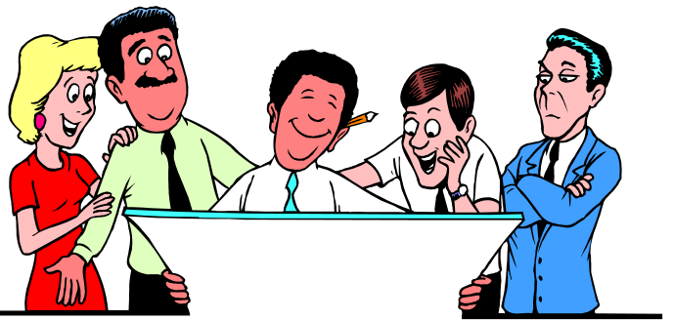

Advantages and Disadvantages of Group-Aided Decision Making
Advantages Disadvantages
1. Greater pool of knowledge 1. Social pressure
2. Different perspectives 2. Minority domination
3. Greater comprehension 3. Goal displacement
4. Increased acceptance 4. “Groupthink”
5. Training ground

Slide 43
Decision making model
1. Identify
problem
6. Evaluate
decision
2. Choose
decision
style
5. Implement
solution
3. Develop
alternatives
4. Choose
best solution

Slide 44
How involvement improves decisions
Leads to better definition of problems
Employee
involvement
Improves number and quality of solutions
More likely to select
the best option

Slide 45
Potential Problems in Groups
Social Loafing
Social Facilitation
Groupthink
Groupshift

Slide 46
Social Facilitation
Behavior of an individual can be affected by the presence of others.
  can decrease or increase
  decreases when task is not well known (beginner)
  increases when task is well known (expert)
Process:
  presence of others increases anxiety
  if a beginner, anxiety hinders behavior
  if an expert, anxiety enhances behavior

Slide 47
Group Phenomenon
Groupthink - a deterioration of mental efficiency, reality testing, and moral judgment resulting from in-group pressures
Group Polarization - the tendency for group discussion to produce shifts toward more extreme attitudes among members

Slide 48
Preventing Groupthink
Ask each group member to act as critical evaluator
Have the leader avoid stating his opinion prior to the group decision
Create several groups to work simultaneously
Appoint a devil’s advocate
Evaluate the competition carefully
After consensus, encourage rethinking the position

Slide 49

Let’s stop it here

Slide 50
Summary

Slide 51
Group Problem Solving Techniques
Consensus presenting opinions and gaining agreement to support a decision
Brainstorming process to generate a quantity of ideas
Nominal Group Technique process to generate ideas and evaluate solutions
Delphi Technique process to generate ideas from physically dispersed experts
Computer-Aided Decision Making

Slide 52
Ethics Check
Is it legal?
  Does it violate law
  Does it violate
  company policy
Is it balanced?
  Is it fair to all
  Does it promote win-win relationships
How will it make me feel about myself

Slide 53
Decision making model
1. Identify
problem
6. Evaluate
decision
2. Choose
decision
style
5. Implement
solution
3. Develop
alternatives
4. Choose
best solution

Slide 54
How involvement improves decisions
Leads to better definition of problems
Employee
involvement
Improves number and quality of solutions
More likely to select
the best option

Slide 55
Next….

Slide 56
Organizational Behavior
(MGT-502)
Lecture-19

